Slide 1
Programming

Slide 2
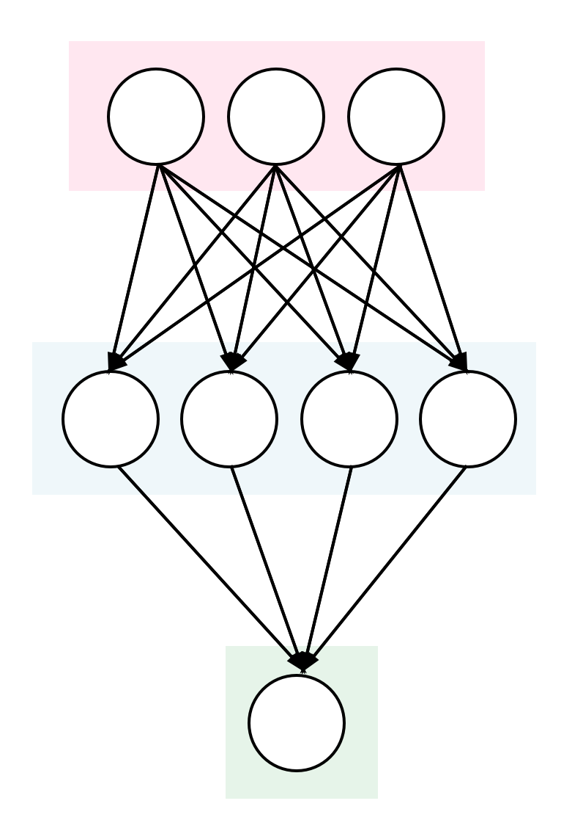
Application Overview
Part 1: convert C-code to Alpaca
Part 2: use Capybara to support sensors
Gesture Sensor
Decode Gesture
Radio
Support Vector Machine – Matrix Multiply

Slide 3
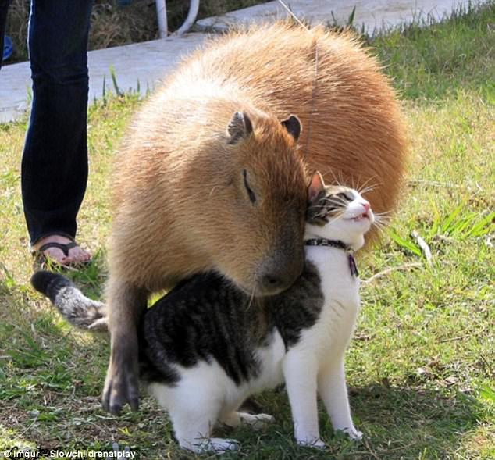
Please be Gentle!
Please do not move any of the attached wires.
Check that the black line on the programming header lines up with the line on the PCB.
Please be careful when attaching and removing antennae.

Slide 4
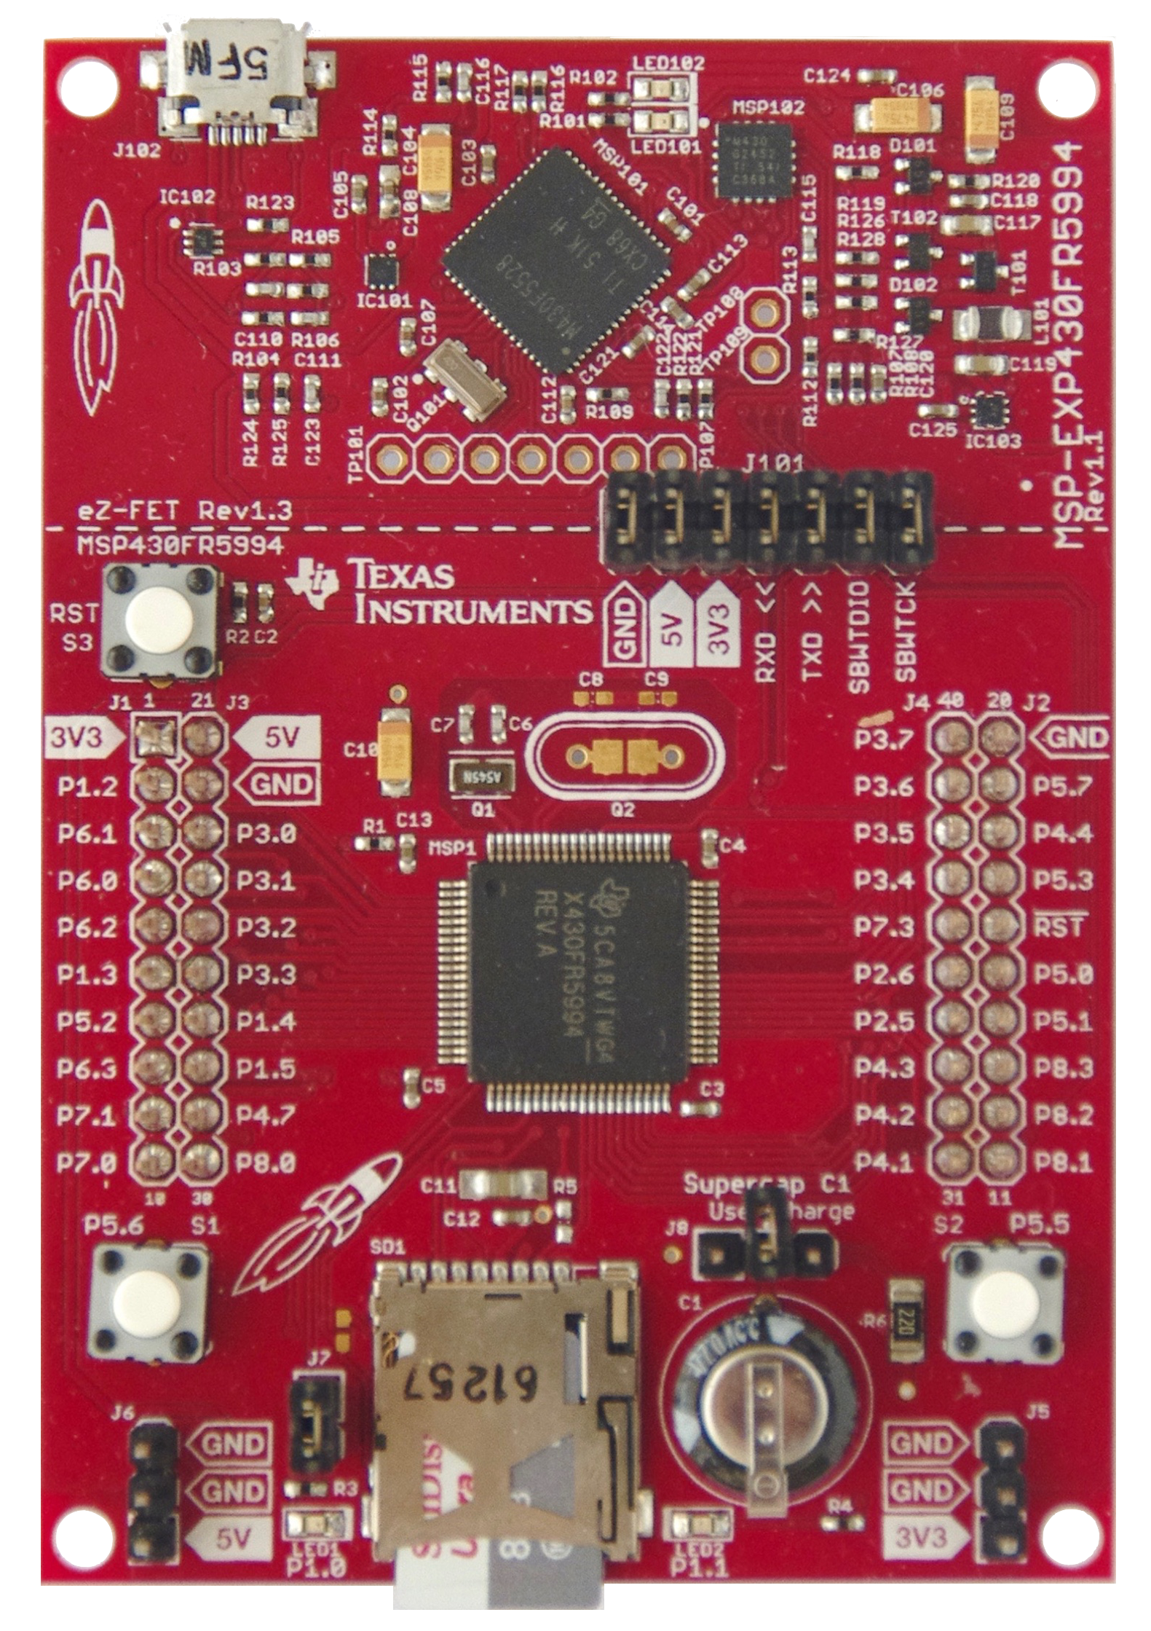
Hardware Explanation

Slide 5
Hardware Explanation
Your Laptop
Capybara
Programmer

Slide 6
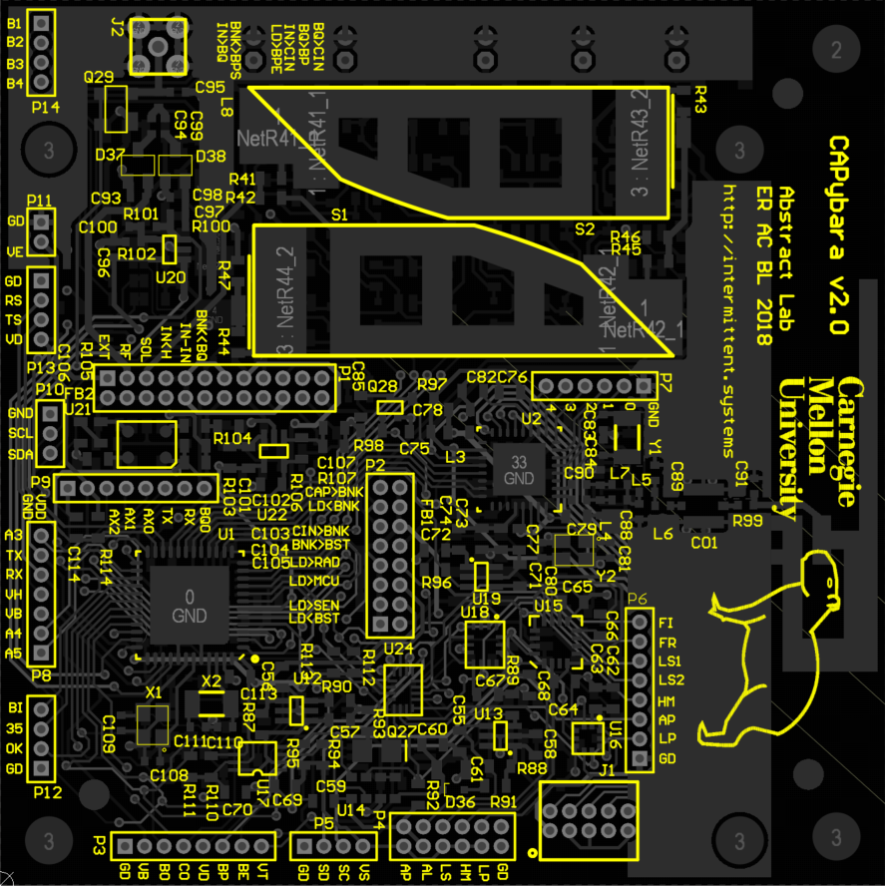
Connections
Don’t Touch!
GND
-
VDD
-
UART
PROGRAM0
PROGRAM1
If disconnected see us

Slide 7
Terminal
Virtual Box + MicroVM
Notes:
Launch VM

Slide 8
ssh -p 2224 \ reviewer@localhost
Password: review

Slide 9
Software
Libraries
Raw Data
Alpaca and Build System
Contains
App Source Code
Transformed Data
Cleaned Data
Data Scripts

Slide 10
Sensor
Radio
SVM
Data
Data

Slide 11
If using USB do 1 only
cd ~/tutorial
git submodule foreach 'git \ stash'
git pull
git submodule update \
--recursive

Slide 12
App Name
GCC/Alpaca
make \ apps/svm_example/bld/gcc/all \ CONSOLE=1

Slide 13
2 Options:
ssh -p 2224 \ reviewer@localhost
screen (advanced users)

Slide 14
Window 1: code
Window 2: serial output
Window 3: mspdebug

Slide 15
Window 2 – serial output
screen /dev/ttyACM1 \ 115200

Slide 16
Window 3 - Programmer
mspdebug –v 2400 \ /dev/ttyACM0 tilib

Slide 17
Window 3 - Programmer
> prog \ apps/svm_example/bld/gcc/\tutorial.out
>run

Slide 18
Look at screen on Window 2 – Serial Output

Slide 19
Now let’s code

Slide 20
vim apps/svm_example/src/main.c

Slide 21
vim apps/part1/src/main.c
TASK_SHARED(<type>, <name>)
TASK_SHARED(<type>, <name>, <size>)
TASK(task_compute);

Slide 22
vim apps/part1/src/main.c
void task_compute() {
TS(<name>) = 4;
TS(<name>, <idx>) = 3;
// TS(<name>, TS(<name>));
}
Does not work

Slide 23
Running Alpaca
make apps/part1/bld/alpaca/all \ CONSOLE=1
Alpaca
Toolchain

Slide 24
Hints
How large should a task be?
Matrix multiply is series of dot products
Control variables often require protection

Slide 25
Your Job Now
Convert the plain-C in svm_example to an Alpaca version
Run on device with printf and with radio (swapping TRANSITION_TOs)

Slide 26
Part 1: matrix multiplication
Port svm_example to alpaca
Part 2: capybara
Support expensive sensor and communication

Slide 27
vim apps/part2/src/main.c
capybara_task_cfg_t pwr_configs[3] = {
CFG_ROW(0, CONFIGD, MED, NA),
CFG_ROW(1, PREBURST, LOW, MEDHIGH),
CFG_ROW(2, BURST, NA, MEDHIGHP),
};
1
2
3
4
Power Mode Options
LOW: Bank 0
MEDLOW: Bank 0,3
MED: Bank 0,3,4
MEDHIGH: Bank 0,1,3
HIGH: Bank 0,1,3,4
0

Slide 28
vim apps/part2/src/main.c
// Requires a ….
capybara_transition(2);

Slide 29
Building Part 2
make apps/part2/bld/alpaca/all \ CONSOLE=1
Alpaca
Toolchain

Slide 30
Hints
Energy: Computation < Radio < APDS
Use the comments to guide you

Slide 31
Your Job Now
Fill out the Capybara table
Annotate the tasks with capybara_transition
Notes:
Annotations of energy point out in code
HERE

Slide 32
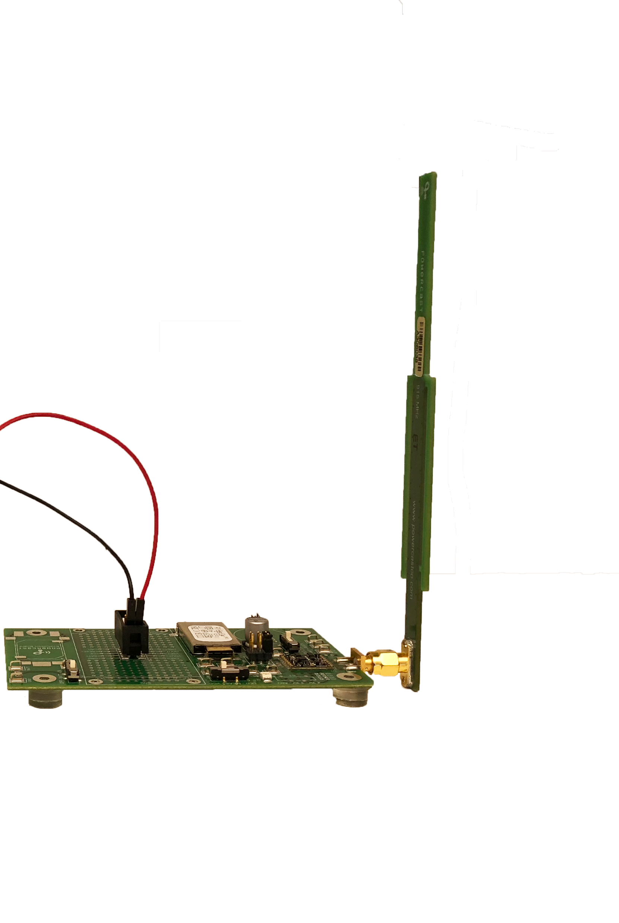
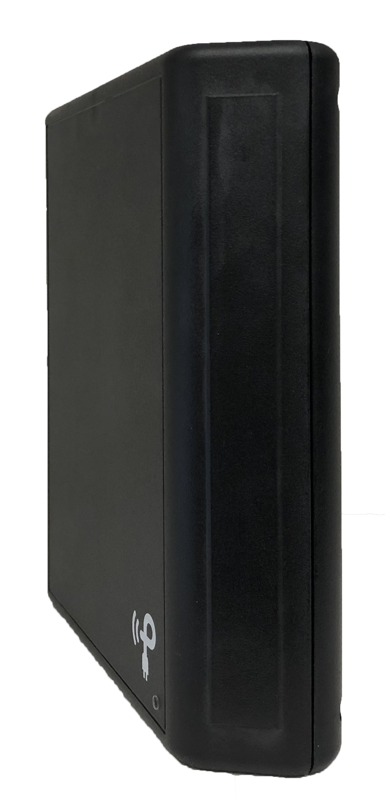
When your done…
make apps/part2/bld/alpaca/all \ CONSOLE=1 \ CONTINUOUS_POWER=0
Bring (capy board) to one of the Harvesting Stations to run on intermittent power

