Slide 1
Getting Started with Intermittent Computing
Organizers: Graham Gobieski, Kiwan Maeng, Emily Ruppel, Milijana Surbatovich, Brandon Lucia
Notes:
Explain why here and what they’re doing
Introduce what the tutorial is. Now we’ll give overview…. Why difficult, what we’re using, etc., we’ll show agenda at end

Slide 2
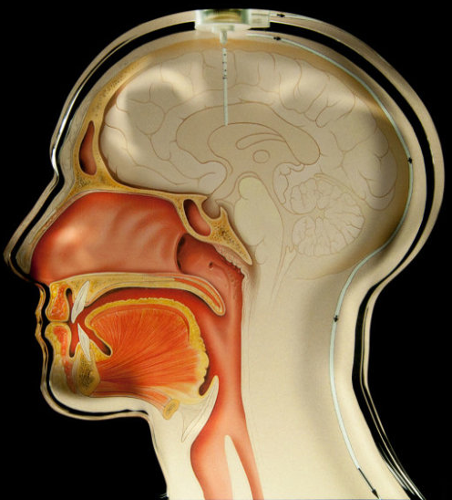
No batteries –> new environments
Harsh, difficult-to-access environments
Maintenance is expensive or intrusive
https://www.nasa.gov/mission_pages/Glory/multimedia/HighRes_Glory_Still03.html
https://www.sciencedaily.com/releases/2014/01/140120090428.htm
https://www.flickr.com/photos/michaelfoleyphotography/4978157199/

Slide 3
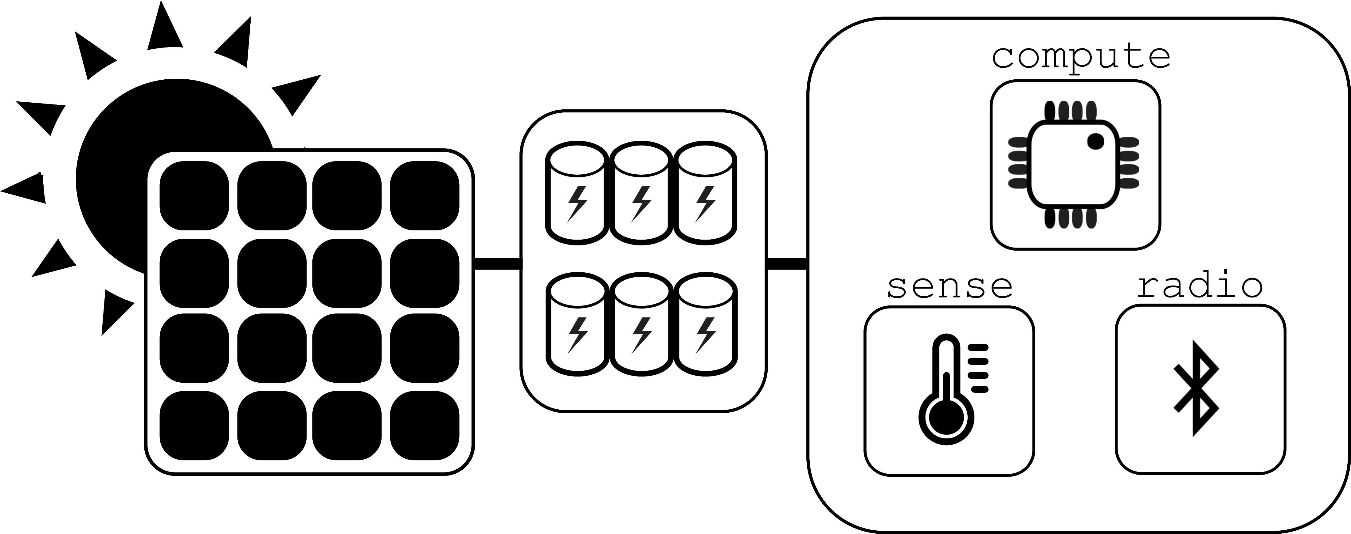
Computing beyond the edge
Battery-free
Energy Harvesting
Intermittently Powered
Harvester
Energy Buffer
MCU & peripherals
Notes:
Explicitly say what intermittent power means

Slide 4
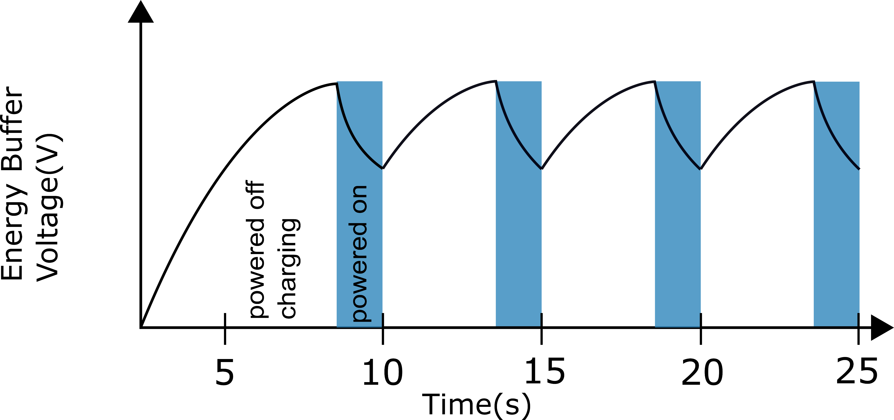
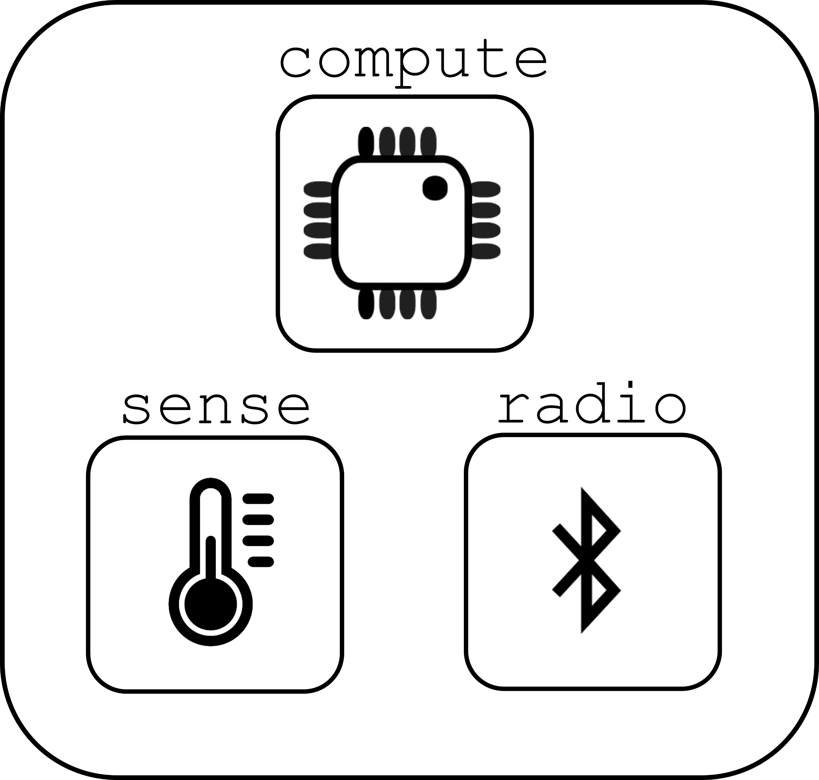
No batteries –> intermittent power supply
Notes:
explain nonvolatile memory!
explain axes

Slide 5
Overview
Progress and Consistency
The Alpaca Programming Model & Runtime System
Temporal Constraints
The Capybara Platform
Open Challenges
Summary

Slide 6
Programs may not finish
int process() {
count++;
buf[count] = accel();
avg = sum(buf)/count;
transmit(avg);
}
count++
buf[count] = accel()
Power fail
Execution Time
Notes:
More detailed explanation WHY volatile/non-volatile etc. Perhaps split to two slides
Add callout saying we need latch, etc.
Make capy bigger

Slide 7
Programs may not finish
int process() {
count++;
buf[count] = accel();
avg = sum(buf)/count;
transmit(avg);
}
count++
buf[count] = accel()
Power fail
Execution Time
count++;
buf[count] = accel()
Power fail
.
.
.
Notes:
More detailed explanation WHY volatile/non-volatile etc. Perhaps split to two slides
Add callout saying we need latch, etc.

Slide 8
Programs may not finish
int process() {
count++;
buf[count] = accel();
avg = sum(buf)/count;
transmit(avg);
}
count++
buf[count] = accel()
Power fail
Execution Time
count++;
buf[count] = accel()
Power fail
.
.
.
Need to latch execution state periodically!
Notes:
More detailed explanation WHY volatile/non-volatile etc. Perhaps split to two slides
Add callout saying we need latch, etc.

Slide 9
Programs may not finish
int process() {
count++;
buf[count] = accel();
avg = sum(buf)/count;
transmit(avg);
}
Execute with checkpoints
count++
buf[count] = accel()
count++
buf[count] = accel()
Checkpoint
Power fail
Power fail
Execution Time
count++;
buf[count] = accel()
Power fail
.
.
.
Need to latch execution state periodically!
Notes:
More detailed explanation WHY volatile/non-volatile etc. Perhaps split to two slides
Add callout saying we need latch, etc.

Slide 10
Programs may not finish
int process() {
count++;
buf[count] = accel();
avg = sum(buf)/count;
transmit(avg);
}
Execute with checkpoints
count++
buf[count] = accel()
count++
buf[count] = accel()
Checkpoint
Power fail
Power fail
Execution Time
count++;
buf[count] = accel()
buf[count] = accel()
avg = sum(buf)/count
transmit-
Power fail
Checkpoint
Power fail
.
.
.
Need to latch execution state periodically!
Notes:
More detailed explanation WHY volatile/non-volatile etc. Perhaps split to two slides
Add callout saying we need latch, etc.

Slide 11
Programs may not finish
int process() {
count++;
buf[count] = accel();
avg = sum(buf)/count;
transmit(avg);
}
Execute with checkpoints
count++
buf[count] = accel()
count++
buf[count] = accel()
Checkpoint
Power fail
Power fail
Execution Time
count++;
buf[count] = accel()
buf[count] = accel()
avg = sum(buf)/count
transmit-
Power fail
Checkpoint
Power fail
.
.
.
Need to latch execution state periodically!
transmit(avg)
Notes:
More detailed explanation WHY volatile/non-volatile etc. Perhaps split to two slides
Add callout saying we need latch, etc.

Slide 12
Memory can become inconsistent
int process() {
count++;
buf[count] = accel();
avg = sum(buf)/count;
transmit(avg);
}
NV Memory
count
0
count++
buf[count] = accel()
buf
7
0
0
Execution Time
Notes:
Add callout for fix
No jargon
icons?
bigger mem state

Slide 13
Memory can become inconsistent
int process() {
count++;
buf[count] = accel();
avg = sum(buf)/count;
transmit(avg);
}
NV Memory
count
1
count++
buf[count] = accel()
Power fail
buf
7
0
0
Execution Time
Notes:
Add callout for fix
No jargon
icons?
bigger mem state

Slide 14
Memory can become inconsistent
int process() {
count++;
buf[count] = accel();
avg = sum(buf)/count;
transmit(avg);
}
NV Memory
count
1
count++
buf[count] = accel()
Power fail
buf
7
0
0
Execution Time
2
count++;
buf[count] = accel()
count
1
buf
7
0
0
9
Need to track or prevent potentially inconsistent variables!
Notes:
Add callout for fix
Make clear non-volatile
icons?
bigger mem state

Slide 15
Memory can become inconsistent
int process() {
count++;
buf[count] = accel();
avg = sum(buf)/count;
transmit(avg);
}
Make working copy of inconsistent variables!
NV Memory
count
1
count++
buf[count] = accel()
1
count++
buf[count] = accel()
Power fail
count
0
Power fail
buf
7
0
0
buf
7
0
0
Execution Time
2
count++;
buf[count] = accel()
count
1
buf
7
0
0
9
Need to track or prevent potentially inconsistent variables!
Notes:
Add callout for fix
No jargon
icons?
Working copy/log

Slide 16
Memory can become inconsistent
int process() {
count++;
buf[count] = accel();
avg = sum(buf)/count;
transmit(avg);
}
Make working copy of inconsistent variables!
NV Memory
count
1
count++
buf[count] = accel()
1
count++
buf[count] = accel()
Power fail
count
0
Power fail
buf
7
0
0
buf
7
0
0
Execution Time
1
count++;
buf[count] = accel()
2
count++;
buf[count] = accel()
count
0
count
1
buf
7
9
buf
7
0
0
0
0
9
Need to track or prevent potentially inconsistent variables!
Notes:
Add callout for fix
No jargon
icons?
bigger mem state

Slide 17
Common Intermittent Execution Models
Checkpoints
Tasks
int main() {
temp = count + 1;
count = temp;
buf[count] = accel();
avg = sum(buf)/count;
transmit(avg);
}
task sample() {
count++;
buf[count] = accel();
task_transition(compute)
}
Transaction semantics, undo/redo logging
Voltage,
time,
program structure,
WARs
task compute() {
avg = sum(buf)/count;
transmit(avg);
}
Easy to use, but
arbitrarily placed checkpoints can break I/O
More programmer involvement, but much more control
B. Ransford, J. Sorber, and K. Fu. Mementos: System support for long-running computation on RFID-scale devices. ASPLOS, 2011.
D. Balsamo, A. S. Weddell, G. V. Merrett, B. M. Al-Hashimi, D. Brunelli and L. Benini.
Hibernus: Sustaining Computation During Intermittent Supply for Energy-Harvesting Systems. IEEE ESL, 2015.
J. Van Der Woude and M. Hicks. Intermittent computation without hardware support or programmer intervention. OSDI, 2016.
J. Hester, K. Storer, and J. Sorber. Timely execution on intermittently powered batteryless sensors. SenSys, 2017.
B. Lucia and B. Ransford. A simpler, safer programming and execution model for intermittent systems. PLDI, 2015.
Notes:
Add citations!

Slide 18
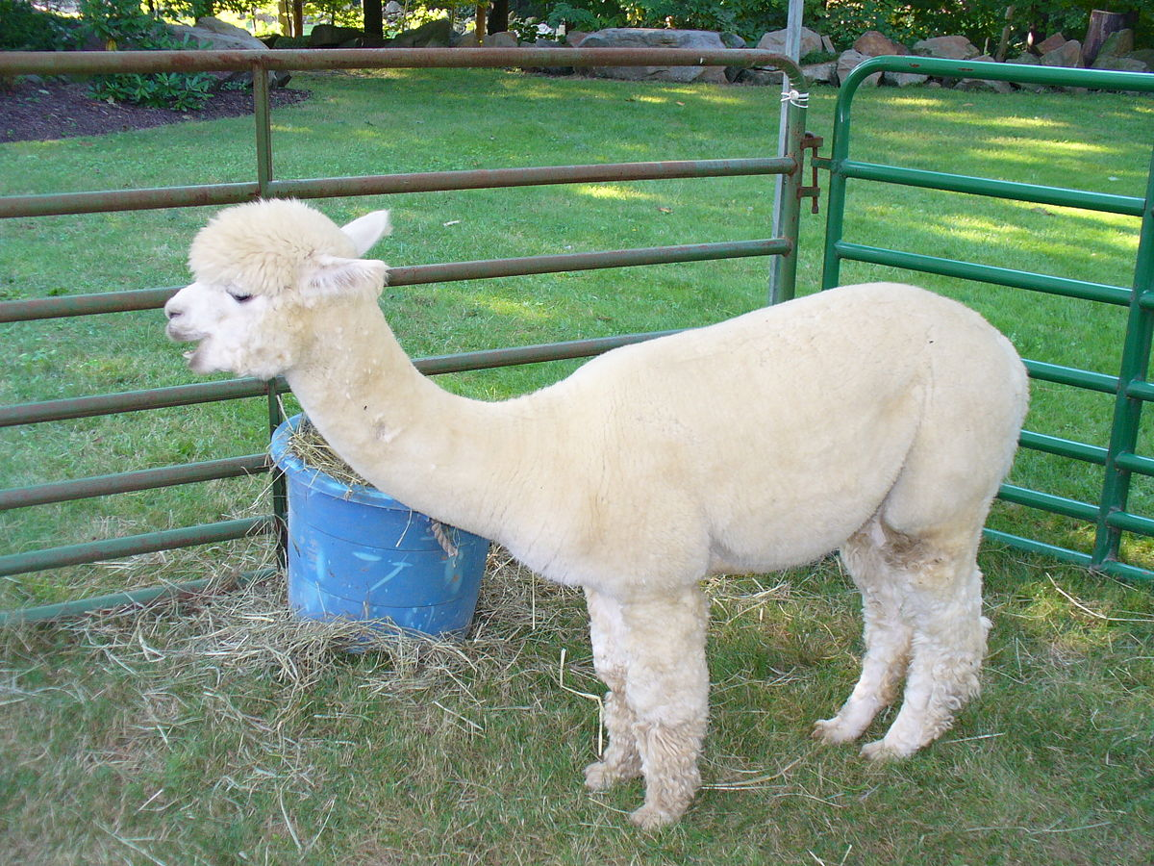
Alpaca – progress and consistency
Execution state latches at task boundaries
Task-based program
Compiler pass privatizes NV variables that can become inconsistent
Privatization analysis
Privatization and commit
Updates to NV memory are only visible once a task has finished
Kiwan Maeng, Alexei Colin, and Brandon Lucia.
Alpaca: Intermittent execution without checkpoints. OOPSLA (2017)
Notes:
citation, alpaca art

Slide 19
Overview
Progress and Consistency
The Alpaca Programming Model & Runtime System
Temporal Constraints
The Capybara Platform
Open Challenges
Summary
Notes:
Call forward abt Kiwan, explaining later

Slide 20
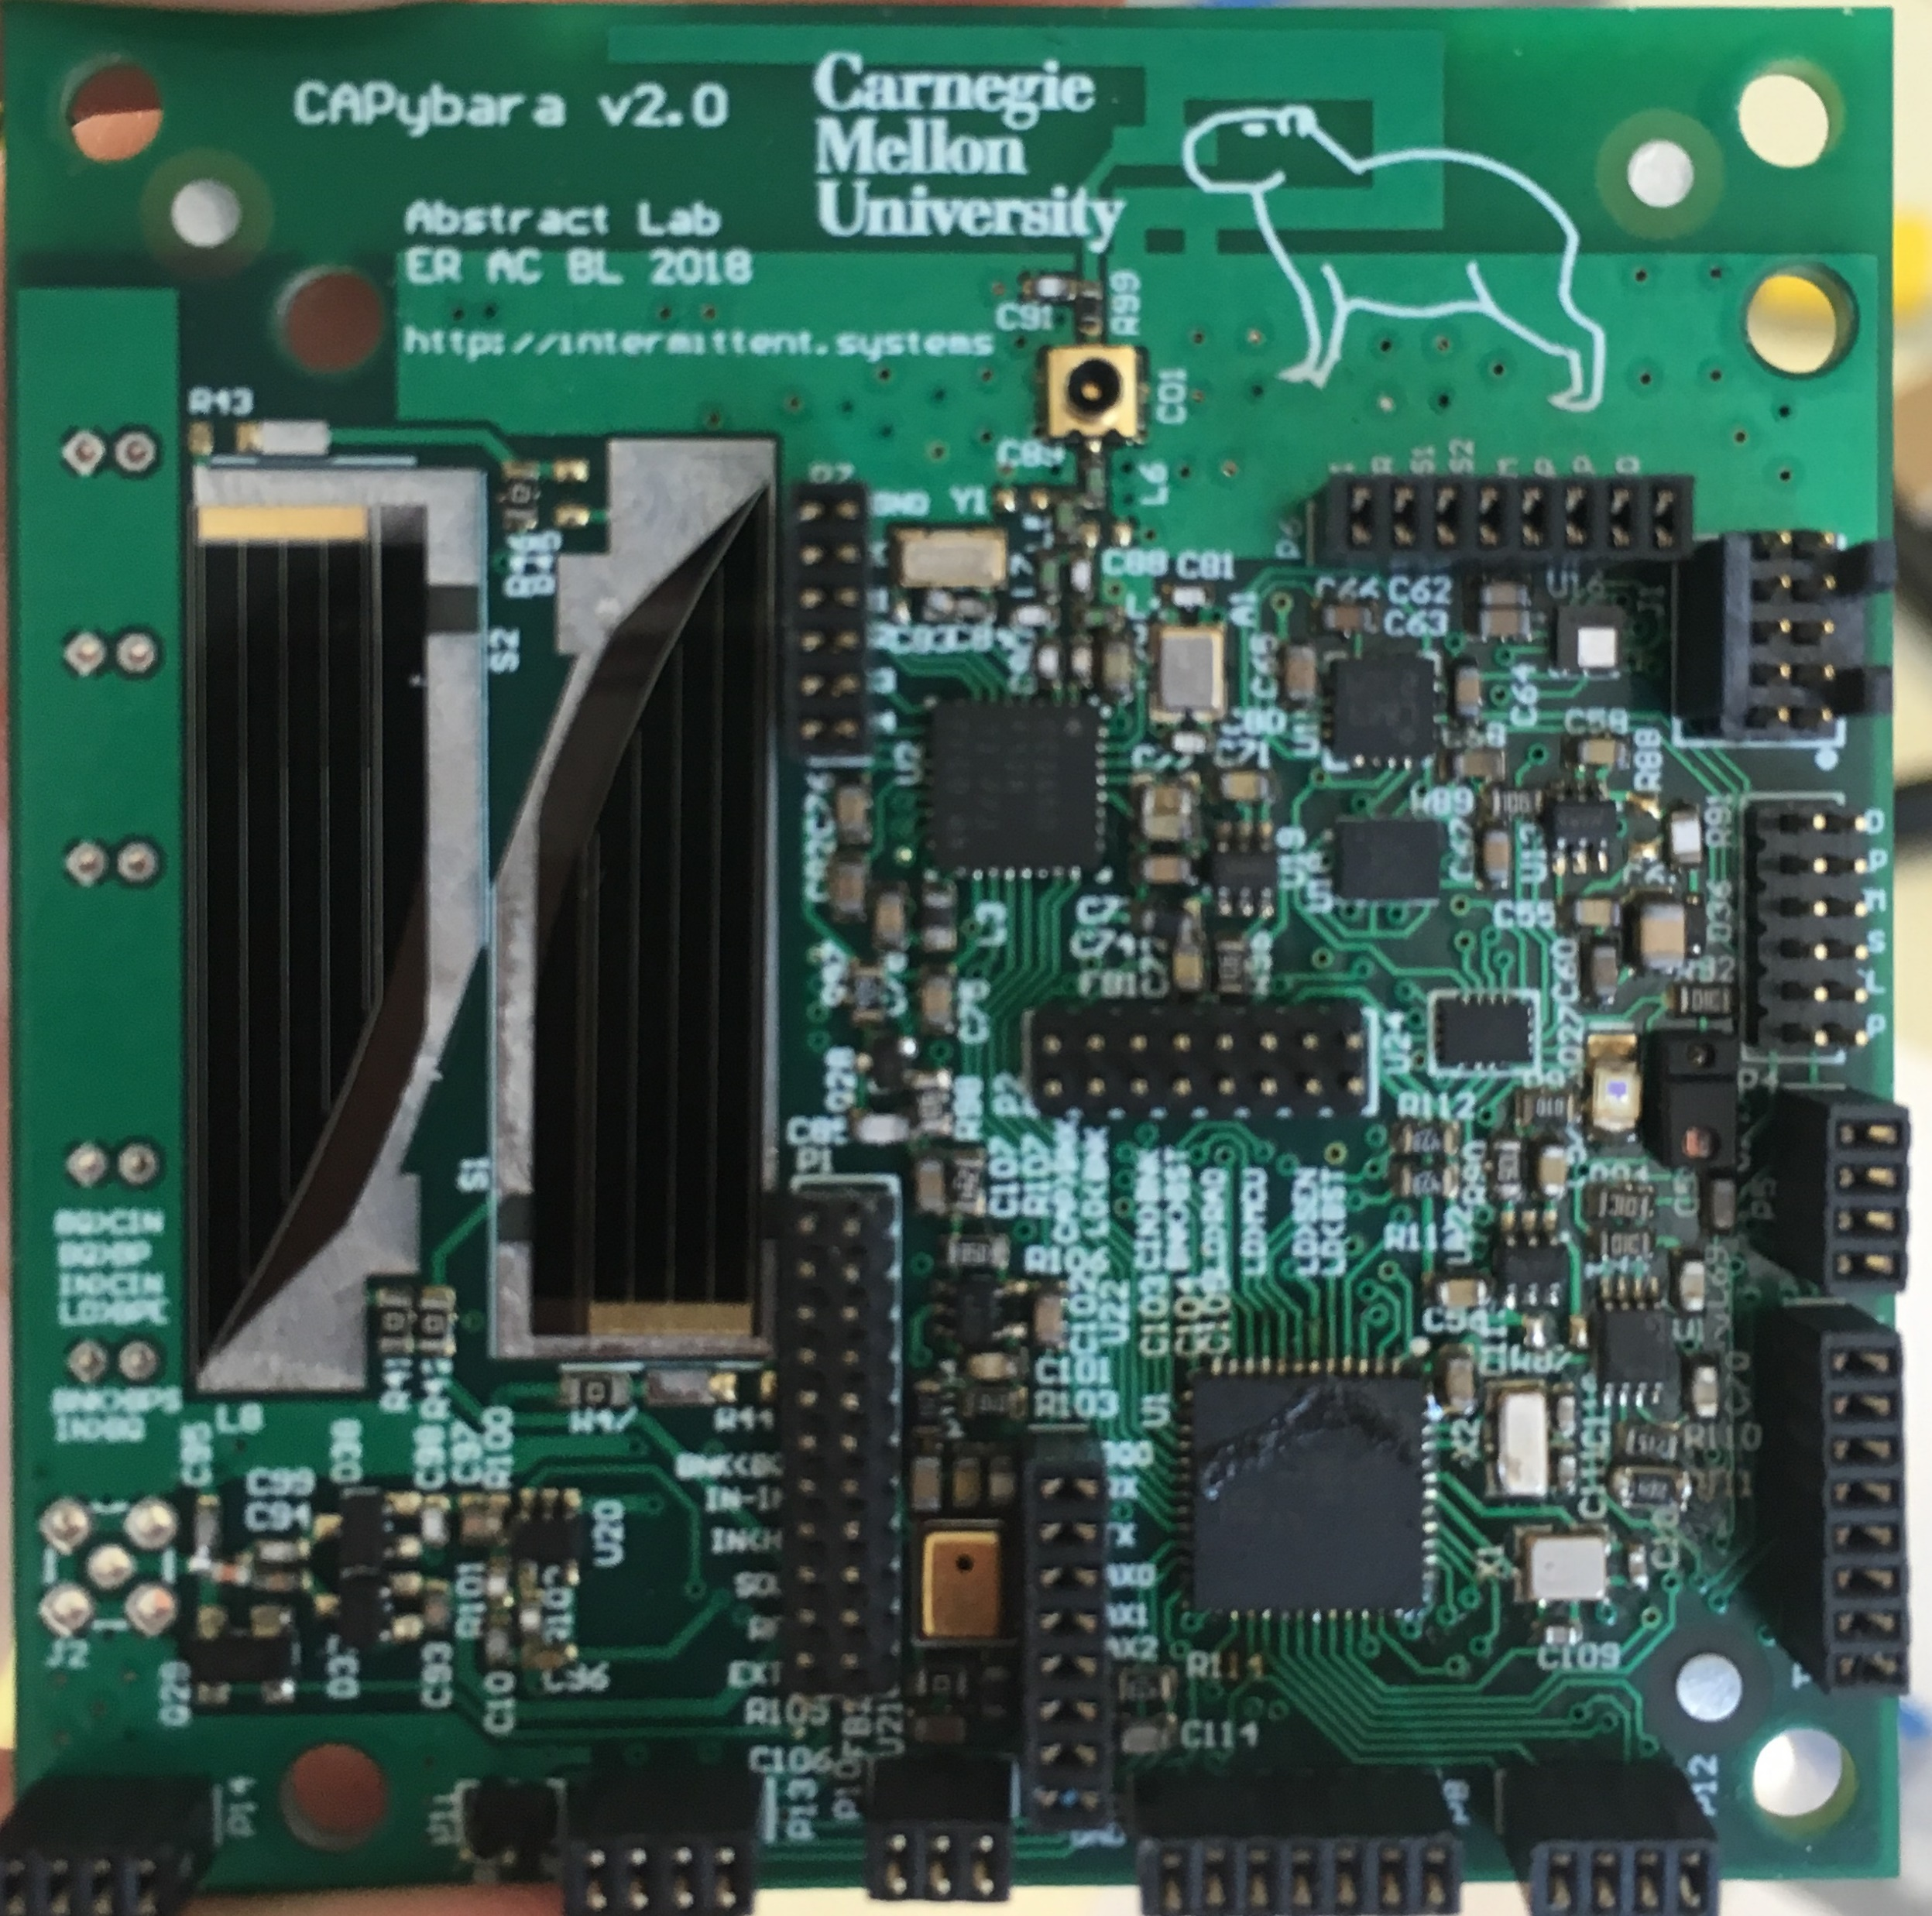
Programs have (implicit) atomicity constraints
int mag_read() {
ASSERT(DEVICE_ON);
ASSERT(BUS_READY);
success = read_I2C(&buf);
if (success){
calX = buf[0]
calY = buf[1]
calZ = buf[2]
}
return success;
}
ASSERT(DEVICE_ON) == true
ASSERT(BUS_READY) == true
Power fail
ASSERT(DEVICE_ON) == false
ASSERT(BUS_READY) == false
read_I2C(&buf)
Notes:
Programmers need to be careful not to break atomic regions between tasks
automatic checkpoint systems should provide a method for specifying atomic regions
Explain what is atomicity! All or nothing semantics. Make actual mag, wrong answer or waiting for the bus, have it hang!

Slide 21
Data can have timeliness constraints
int monitor() {
while (1){
rawT = getTemp();
temp = process(rawT);
if(temp > threshold) {
send(AlARM);
} else {
send(ALL_OK);
}
}
return 0;
}
rawT = getTemp()
temp = proce--
Power fail
temp = process(rawT)
temp > threshold
send(ALARM)
Notes:
Timeliness is …

Slide 22
Enabling Practical Reactive Programs
Catching events
Need to be on frequently
Completing atomic section
Need to be on for a longer time
Reactivity constraint
Atomicity constraint
ON
ON
ON
ON
ON
ON
Time
Time
Asynchronous burst constraint
ON
Time
Event
Notes:
Need to do atomic task, don’t know when

Slide 23
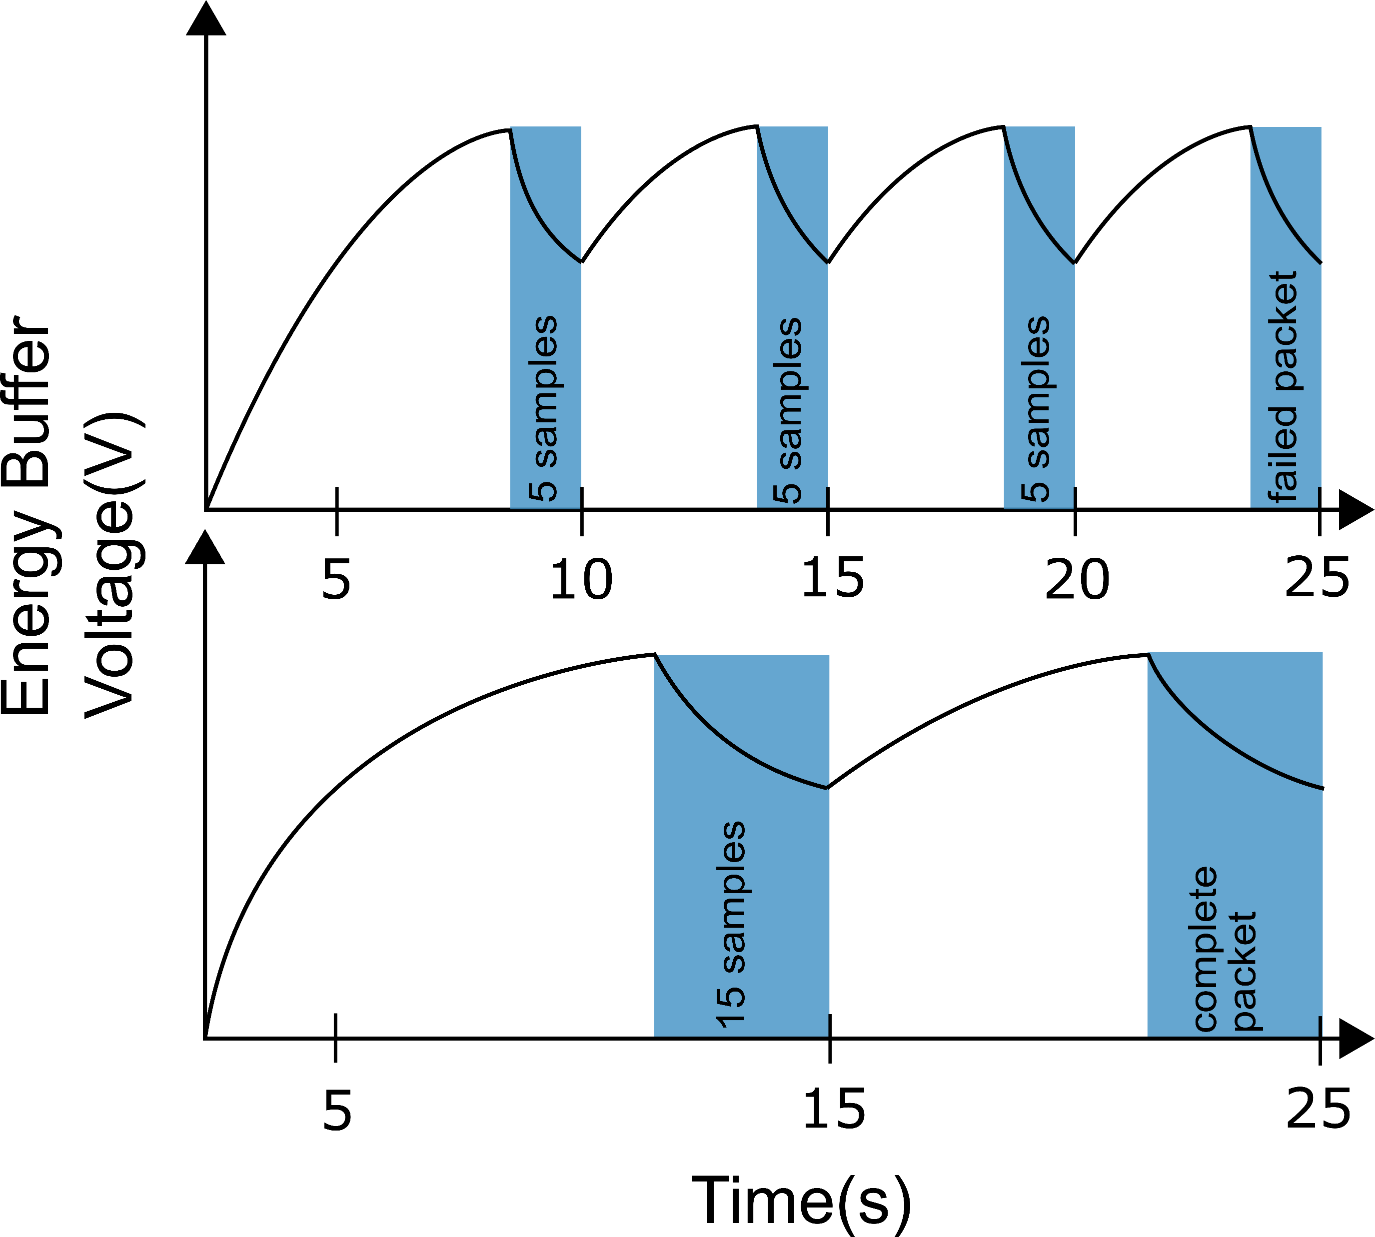
Capacitor size determines the execution model
Can sense frequently, but not transmit
Buffer Capacity = C
Can transmit, but not sense frequently
Buffer Capacity = 3C
Notes:
Put text

Slide 24
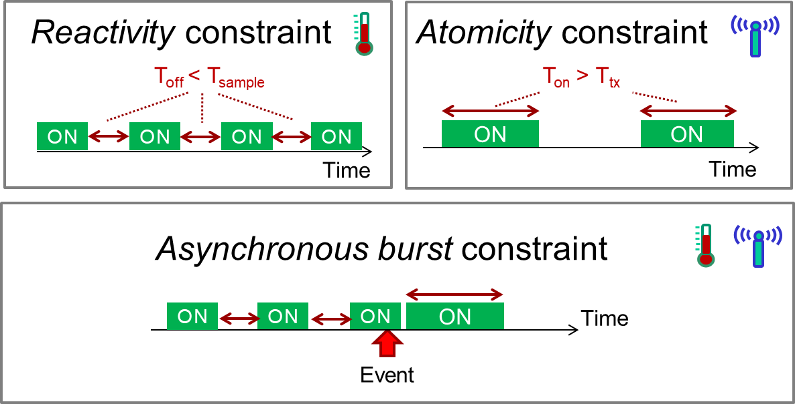
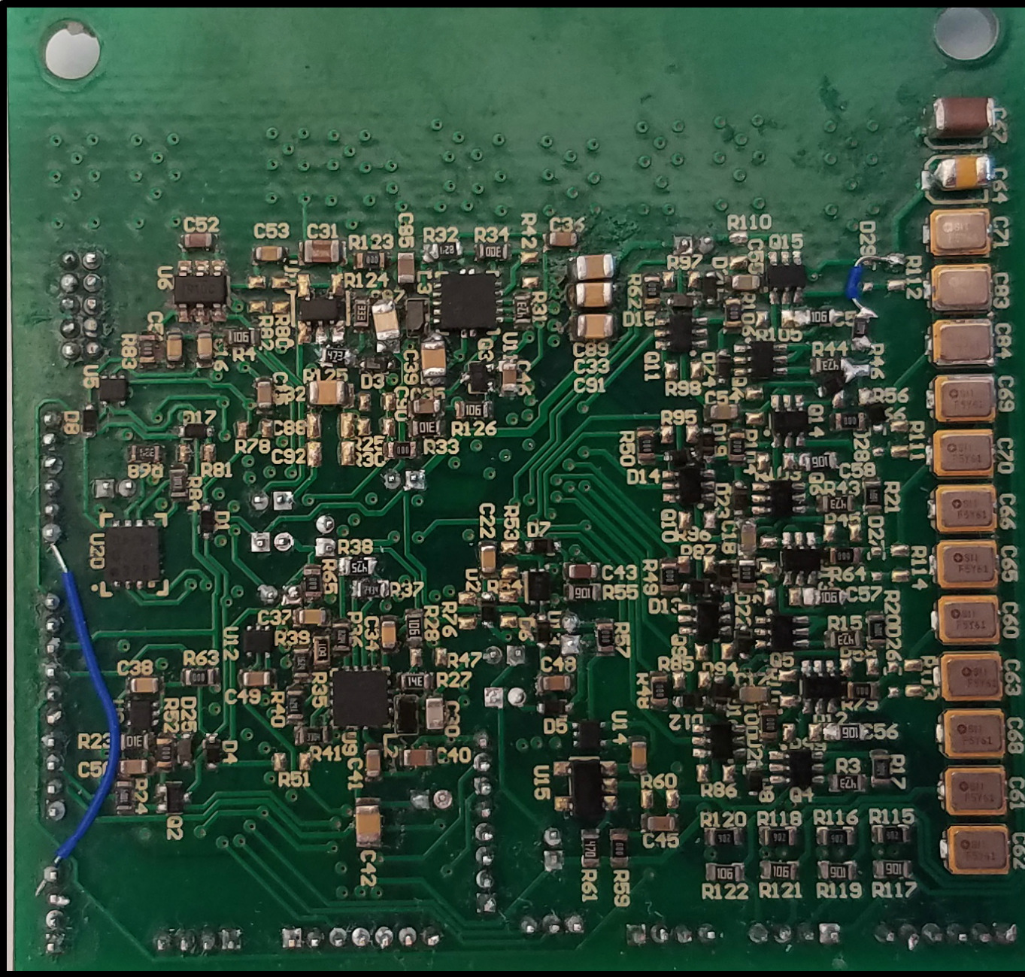
Capybara – a reconfigurable energy platform
Configurable HW
Energy Storage
Programmable Task Energy Modes
Alexei Colin, Emily Ruppel and Brandon Lucia.
A Reconfigurable Energy Storage Architecture for Energy-harvesting Devices. ASPLOS. 2018.

Slide 25
Overview
Progress and Consistency
The Alpaca Programming Model & Runtime System
Temporal Constraints
The Capybara Platform
Open Challenges
Summary

Slide 26
Open challenges
Need better debugging tools
track the effect of input, transient events
Need system support for more sophisticated execution modes
timely execution
concurrency and events
distributed systems?

Slide 27
Summary
Batteryless, energy harvesting device enable new environments
Intermittent Power makes programming difficult
Full stack support is necessary to write correct, interesting applications
Open challenges remain!

Slide 28
Agenda
8:30 – 8:45 Set up, arrivals
8:45 – 9:15 Introduction to Intermittent Computing
9:15 – 9:25 Alpaca Specifics
9:25 – 11:00 Part 1: Write an Intermittence-safe Program (Alpaca)
11:00 – 11:10 Break :)
11:10 – 11:20 Capybara Specifics
11:20 – 11:50 Part 2: Write a Reactive Program (Capybara)
11:50 – 12:00 Wrap-up
Notes:
handout: schematics, photo, (any changes to set up with pictures) ref sheet for programming w/ alpaca and capy
tutorial: quite specific to program that they’re using, small to large prog. capy: start from last alpaca -> adding capy
feedback form.
Support vector machine in C -> alpaca ->, sensing (lots of energy!) -> capybara

Slide 29
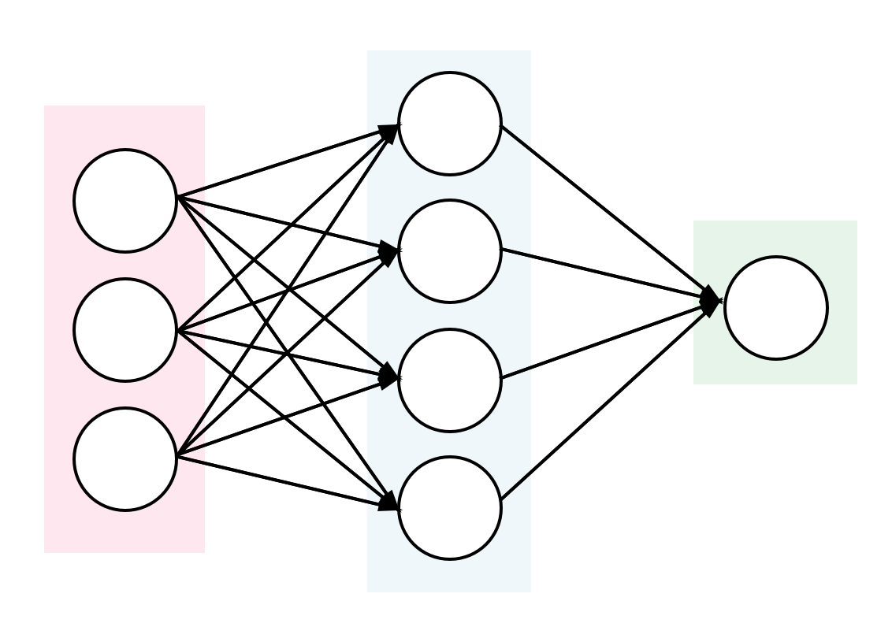
Part 1: Make a C program intermittence-safe
C Program
Alpaca Program
SVM:

Slide 30
Agenda
8:30 – 8:45 Set up, arrivals
8:45 – 9:15 Introduction to Intermittent Computing
9:15 – 9:25 Alpaca Specifics
9:25 – 11:00 Part 1: Write an Intermittence-safe Program (Alpaca)
11:00 – 11:10 Break :)
11:10 – 11:20 Capybara Specifics
11:20 – 11:50 Part 2: Write a Reactive Program (Capybara)
11:50 – 12:00 Wrap-up
Notes:
handout: schematics, photo, (any changes to set up with pictures) ref sheet for programming w/ alpaca and capy
tutorial: quite specific to program that they’re using, small to large prog. capy: start from last alpaca -> adding capy
feedback form.
Support vector machine in C -> alpaca ->, sensing (lots of energy!) -> capybara

Slide 31
Part 2: Make a Capybara Program
Alpaca Program
Capybara Program

Slide 32
Alpaca: Intermittent Execution Without Checkpoints
Notes:
I will introduce our new programming model called Alpaca, which enables efficient program execution on energy-harvesting devices. And will be used throughout the tutorial.

Slide 33
Overview
Task-Based Programming Model
Compiler-Automated Data Privatization
Efficient Runtime Library
Notes:
Alpaca consists of three parts

Slide 34
Overview
Task-Based Programming Model
Compiler-Automated Data Privatization
Efficient Runtime Library
More detail on:
Kiwan Maeng, Alexei Colin, and Brandon Lucia. "Alpaca: Intermittent execution without checkpoints." OOPSLA (2017)
Notes:
Today, for the purpose of the tutorial, I will only explain its programming model in detail– especially emphasizing its syntax.
If you are interested in the rest of the system, please read our paper from OOPSLA 2017

Slide 35
Alpaca: Task-Based Programming
cnt = 0;
while (1) {
while (cnt < 5) {
data[cnt] = sensor_read();
cnt++;
}
radio_tx(data);
cnt = 0;
}
Notes:
Now lets see how to program in Alpaca language.
To program in Alpaca, the programmer has to write the code as a sequence of task.
(explain code)

Slide 36
Divide the Workload Into Tasks
task_init
cnt = 0;
while (1) {
while (cnt < 5) {
data[cnt] = sensor_read();
cnt++;
}
radio_tx(data);
cnt = 0;
}
task_sense
task_tx
Notes:
I’ll divide it into three tasks.

Slide 37
Divide the Workload Into Tasks
task_init
cnt = 0;
while (1) {
while (cnt < 5) {
data[cnt] = sensor_read();
cnt++;
}
radio_tx(data);
cnt = 0;
}
task_sense
task_tx
task_init
task_sense
task_tx
Notes:
Then, our ultimate goal is to define the control flow between the tasks, like this
If you write the program as a sequence of task, on a power failure, Alpaca remembers the last executing task, and start again from that task on reboot.
So, you don’t need any checkpointing, and the structure of the tasks preserve progress.
Each task has to be small enough --- if power fails~~

Slide 38
Declare Tasks: TASK() Keyword
TASK(task_init);
TASK(task_sense);
TASK(task_tx);

Slide 39
Define Tasks: Void Function With task_
TASK(task_init);
TASK(task_sense);
TASK(task_tx);
void task_sense() {
data[cnt] = sensor_read();
cnt++;
if (cnt < 5)
TRANSITION_TO(task_sense);
else
TRANSITION_TO(task_tx);
}
void task_init() {
cnt = 0;
TRANSITION_TO(task_sense);
}
void task_tx() {
…
radio_tx(data);
cnt = 0;
TRANSITION_TO(task_sense);
}
* Tasks should always start with a prefix task_
Notes:
At the end of each task, you have to pass the control flow to a next task that should be executed, using TRANSITION_TO keyword.
(go through the example)
To sum up, two things to remember, is

Slide 40
Declare Task Shared Vars: TASK_SHARED()
TASK(task_init);
TASK(task_sense);
TASK(task_tx);
void task_sense() {
data[cnt] = sensor_read();
cnt++;
if (cnt < 5)
TRANSITION_TO(task_sense);
else
TRANSITION_TO(task_tx);
}
void task_init() {
cnt = 0;
TRANSITION_TO(task_sense);
}
void task_tx() {
…
radio_tx(data);
cnt = 0;
TRANSITION_TO(task_sense);
}
Notes:
So as you can see, tasks does not receive any arguments. So they pass data across each other using a global variable, or a task-shared variable.
As you can see…
Each tasks can be partially executed multiple times on a power failure, and it can cause memory inconsistency.
So Alpaca compiler protects task-shared vars by analyzing the code and using logging. But you do not need to know all the details,

Slide 41
Declare Task Shared Vars: TASK_SHARED()
TASK(task_init);
TASK(task_sense);
TASK(task_tx);
void task_sense() {
data[cnt] = sensor_read();
cnt++;
if (cnt < 5)
TRANSITION_TO(task_sense);
else
TRANSITION_TO(task_tx);
}
void task_init() {
cnt = 0;
TRANSITION_TO(task_sense);
}
TASK_SHARED(int, cnt);
TASK_SHARED(int, data, 5);
void task_tx() {
…
radio_tx(data);
cnt = 0;
TRANSITION_TO(task_sense);
}
Notes:
They don’t have arguments, they use global var

Slide 42
Declare Task Shared Vars: TASK_SHARED()
TASK(task_init);
TASK(task_sense);
TASK(task_tx);
void task_sense() {
data[cnt] = sensor_read();
cnt++;
if (cnt < 5)
TRANSITION_TO(task_sense);
else
TRANSITION_TO(task_tx);
}
void task_init() {
cnt = 0;
TRANSITION_TO(task_sense);
}
type
name
TASK_SHARED(int, cnt);
TASK_SHARED(int, data, 5);
type
void task_tx() {
…
radio_tx(data);
cnt = 0;
TRANSITION_TO(task_sense);
}
name
(array size)
Notes:
They don’t have arguments, they use global var

Slide 43
Mark Task Shared Vars: TS()
TASK(task_init);
TASK(task_sense);
TASK(task_tx);
void task_sense() {
int tmp = TS(cnt);
TS(data, tmp) = sensor_read();
TS(cnt)++;
if (TS(cnt) < 5)
TRANSITION_TO(task_tx);
else
TRANSITION_TO(task_sense);
}
void task_init() {
TS(cnt) = 0;
TRANSITION_TO(task_sense);
}
TASK_SHARED(int, cnt);
TASK_SHARED(int, data, 5);
void task_tx() {
…
radio_tx(TS(data));
TS(cnt) = 0;
TRANSITION_TO(task_sense);
}
Notes:
TS keyword which is a short for task-shared

Slide 44
Mark Task Shared Vars: TS()
name
(array idx)
TASK(task_init);
TASK(task_sense);
TASK(task_tx);
void task_sense() {
int tmp = TS(cnt);
TS(data, tmp) = sensor_read();
TS(cnt)++;
if (TS(cnt) < 5)
TRANSITION_TO(task_tx);
else
TRANSITION_TO(task_sense);
}
void task_init() {
TS(cnt) = 0;
TRANSITION_TO(task_sense);
}
TASK_SHARED(int, cnt);
TASK_SHARED(int, data, 5);
name
void task_tx() {
…
radio_tx(TS(data));
TS(cnt) = 0;
TRANSITION_TO(task_sense);
}
Notes:
This can also be easily automated using a compiler, but we just built it this way, sorry about that.

Slide 45
Define the Entry Task
TASK(task_init);
TASK(task_sense);
TASK(task_tx);
void task_sense() {
int tmp = TS(cnt);
TS(data, tmp) = sensor_read();
TS(cnt)++;
if (TS(cnt) == 5)
TRANSITION_TO(task_sense);
else
TRANSITION_TO(task_tx);
}
void task_init() {
TS(cnt) = 0;
TRANSITION_TO(task_sense);
}
TASK_SHARED(int, cnt);
TASK_SHARED(int, data, 5);
ENTRY_TASK(task_init);
void task_tx() {
…
radio_tx(TS(data));
TS(cnt) = 0;
TRANSITION_TO(task_sense);
}
Notes:
This can also be easily automated using a compiler, but we just built it this way, sorry about that.

Slide 46
Define the Initialization Function
TASK(task_init);
TASK(task_sense);
TASK(task_tx);
void task_sense() {
int tmp = TS(cnt);
TS(data, tmp) = sensor_read();
TS(cnt)++;
if (TS(cnt) == 5)
TRANSITION_TO(task_sense);
else
TRANSITION_TO(task_tx);
}
void task_init() {
TS(cnt) = 0;
TRANSITION_TO(task_sense);
}
TASK_SHARED(int, cnt);
TASK_SHARED(int, data, 5);
ENTRY_TASK(task_init);
INIT_FUNC(init);
void task_tx() {
…
radno_tx(TS(data));
TS(cnt) = 0;
TRANSITION_TO(task_sense);
}
void init() {
disable_watchdog_timer();
configure_clock();
reset_gpio();
}
Notes:
Do not bother if you are unfamiliar. We do it for you

Slide 47
Complete Program:
void task_init() {
TS(cnt) = 0;
TRANSITION_TO(task_sense);
}
TASK(task_init);
TASK(task_sense);
TASK(task_send);
void task_sense() {
int tmp = TS(cnt);
TS(data, tmp) = sensor_read();
TS(cnt)++;
if (TS(cnt) == 5)
TRANSITION_TO(task_sense);
else
TRANSITION_TO(task_tx);
}
TASK_SHARED(int, cnt);
TASK_SHARED(int, data, 5);
ENTRY_TASK(task_init);
INIT_FUNC(init);
void init() {
disable_watchdog_timer();
configure_clock();
reset_gpio();
}
void task_tx() {
…
send_ble(TS(data));
TS(cnt) = 0;
TRANSITION_TO(task_sense);
}
Notes:
Do not bother if you are unfamiliar. We do it for you

Slide 48
Implementation-Specific Caveats
TS(array, TS(val)) = 3; does not work. Instead, do:
int tmp = TS(val);
TS(array, tmp) = 3;
Current pointer analysis is not perfect, so don’t do this:
Do not reference task-shared array using pointers.
e.g., instead of *(TS(arr) + i), always do TS(arr, i)
No n-D array!
Only 1-D array works nicely for now
Do not use task-shared pointers pointing to a task-shared variable.
e.g., do not TS(ptr) = &TS(val);
Notes:
These are some things you can’t do while programming in Alpaca.
This is mostly not fundamental to the idea, but rather an implementation bug, I would say.
…
These limitations are here mostly because I wrote Alpaca in my first year. Sorry about that.

Slide 49
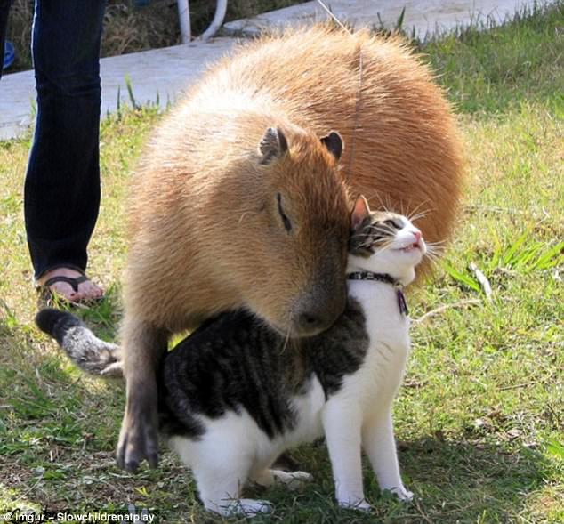
Please be Gentle!
Please do not move any attached wires.
Check that the silver line on the programming header lines up with the “GD” label on the PCB.
Touch the ground on the launchpad before touching the board.
Please be careful when attaching and removing antennae.
Please keep all food and drink away from the boards.

Slide 50
Capybara Introduction: Hardware-Software Co-Design for Reactive Applications
Notes:
Bigger board

Slide 51
Fixed Energy Buffer Problem
FAILED packet transmission
sample
sample
sample
Buffer Capacity = C
Energy Buffer Voltage
Long recharge interval
Back-to-Back Samples
Packet transmitted
Buffer Capacity = 3C
Time
Notes:
Label stuff, add more, bigger label

Slide 52
System Overview
Hardware
Flexible power system
Reconfigurable capacitor bank
Software
Runtime to manage state changes
Declarative interface for energy modes

Slide 53
System Overview
Hardware
Flexible power system
Reconfigurable capacitor bank
Software
Runtime to manage state changes
Declarative interface for energy modes

Slide 54
Reconfigurable Capacitor Bank
Vdd
Switch N
Capacitor
Bank N
...
Switch 1
Capacitor
Bank 1
GPIO
MCU
Notes:
Take the circuit out. simplify

Slide 55
Energy Modes
Temporal constraints
Energy capacity constraints
while(light > CLOSE_OBJECT) {
light = read_photoresistor();
}
gesture = capture_gesture();
radio_transmit(gesture);
}
Temporal
constraint
BOTH
Capacity
constraint
Notes:
Refine audio. Interpret pseudo code

Slide 56
Energy Modes
Preburst:exec=LOW,preburst=HIGH
task_sample(){
light = read_photoresistor()
if(light < CLOSE_OBJECT)
TRANSITION_TO(task_gesture)
else
TRANSITION_TO(task_sample)
}
Burst:burst=HIGH
task_gesture() {
TS(gesture) =apds_get_gesture()
if(TS(gesture) > NONE)
TRANSITION_TO(task_send)
else
TRANSITION_TO(task_sample)
}
Config:exec=MED
task_send() {
radio_send(TS(gesture))
TRANSITION_TO(task_sample)
}
56
Notes:
=assume everything is broken into task, some things are capybara tasks
Refine code
Take extraneous stuff out, mention that it’s alpaca syntax

Slide 57
Syntax
Power configuration table
CFG_ROW(#,type,exec config,(pre)burst config)
capybara_task_cfg_t pwr_configs[3] = {
CFG_ROW(0, PREBURST, LOW, HIGH),
CFG_ROW(1, BURST, NA, HIGH),
CFG_ROW(2, CONFIGD, MED,NA)
};
Capybara transition calls
capybara_transition(<cfg row number>);
Notes:
Go with config table number, arbitrary id
Mention that you have to call transition, transition capybara modes

Slide 58
Mode Options
Power Mode Options
LOW: Bank 0
MEDLOW: Bank 0,3
MED: Bank 0,3,4
MEDHIGH: Bank 0,1,3
HIGH: Bank 0,1,3,4
1
2
3
4
0
Notes:
Telling you what modes to use so you don’t have to think about it

Slide 59
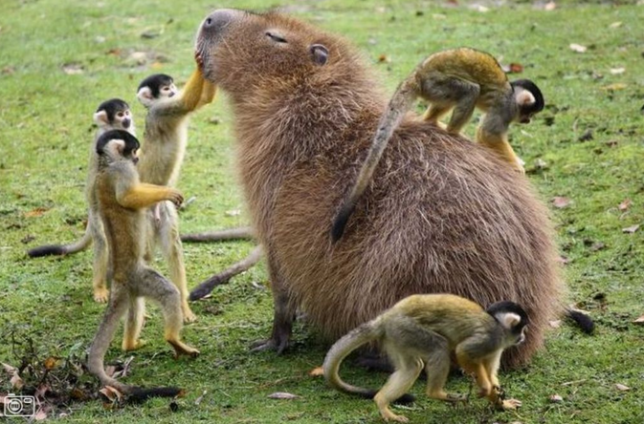
Please be Gentle!
Please do not move any of the attached wires.
Check that the silver line on the programming header lines up with the “GD” label on the PCB.
Touch the ground on the launchpad before touching the board.
Please be careful when attaching and removing antennae.
Please keep all food and drink away from the boards.

